Slide 1
NER for acknowledgments
Sebastian Deręgowski
Klaudia Gruszkowska
Dawid Janus
Bartosz Jamroży

Slide 2
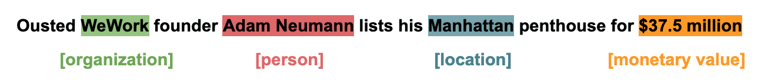
NER
NER stands for Named Entity Recognition, which is a subtask of natural language processing (NLP). It is a technique that aims to identify and classify entities within text into predefined categories such as names of persons, organizations, locations, dates, percentages, and more. In other words, NER is used to extract structured information from unstructured text by identifying and tagging words or phrases that represent specific entities or concepts.

Slide 3
Acknowledgments
In a research paper, an acknowledgement section is a brief portion at the beginning or end of the paper where authors express their gratitude and appreciation to individuals, organizations, or institutions that have provided support, assistance, or resources during the research process but are not considered co-authors of the paper.
This section is a way for the authors to recognize those who have contributed in various ways that do not warrant authorship credit but are still significant to the research project.

Slide 4
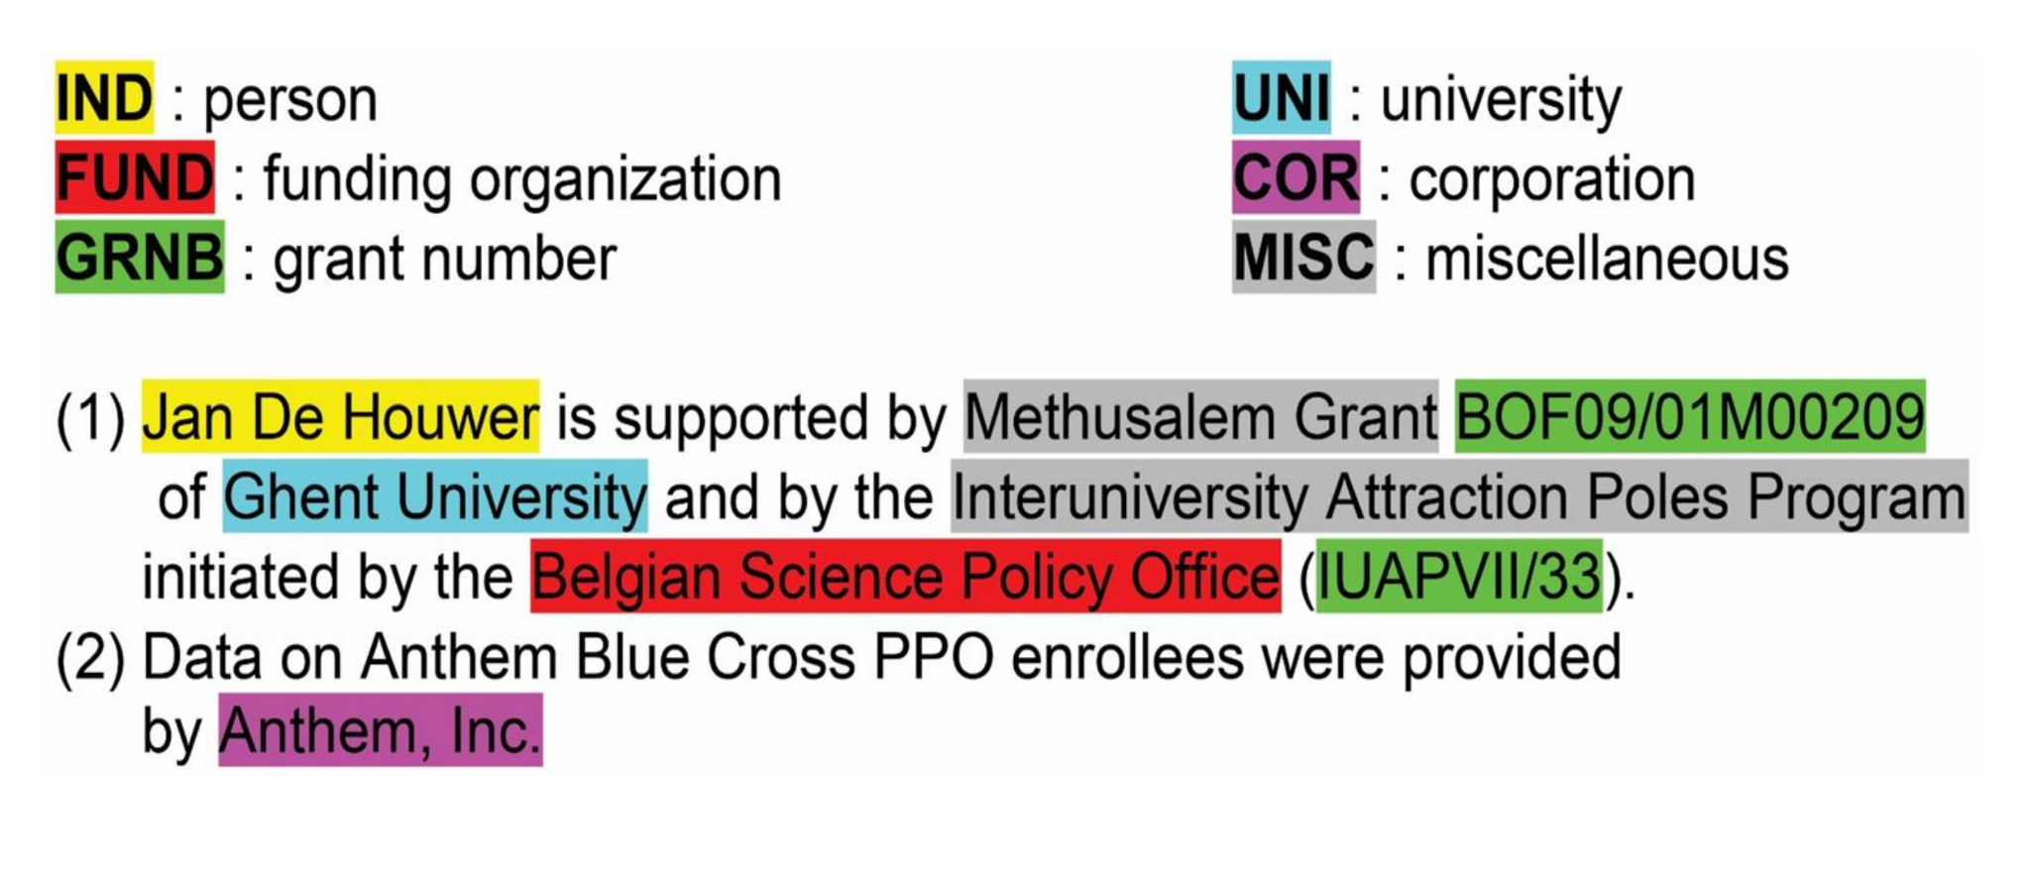
Entity types

Slide 5
Goal of the project
The aim of our project is to develop and evaluate named entity recognition (NER) models for identifying and classifying entities in acknowledgements. We plan to build our work on the foundations of the paper written by Smirnova N., Mayr P. “Embedding models for supervised automatic extraction and classification of named entities in scientific acknowledgements” by training the models presented in the paper on the provided data and conducting their own evaluation.

Slide 6
Significance of the project
We focus on the identification and classification of entities in scientific acknowledgements, which is a significant challenge in the field of natural language processing. With the growth of scientific data, understanding the implicit relationships and collaborations of scientists in acknowledgements becomes particularly important. By identifying key individuals in scientific acknowledgements and analysing their interrelationships, our findings may facilitate the understanding of key figures in the field of science.

Slide 7
Research questions
What techniques and models in the field of NLP are most effective for recognising named individuals in a specific area?
How does the performance of NER models change with amounts of training data?
Can the use of different text normalisation techniques, such as lemmatization or stop word removal, improve the effectiveness of NER models in identifying entities in scientific acknowledgement texts?

Slide 8
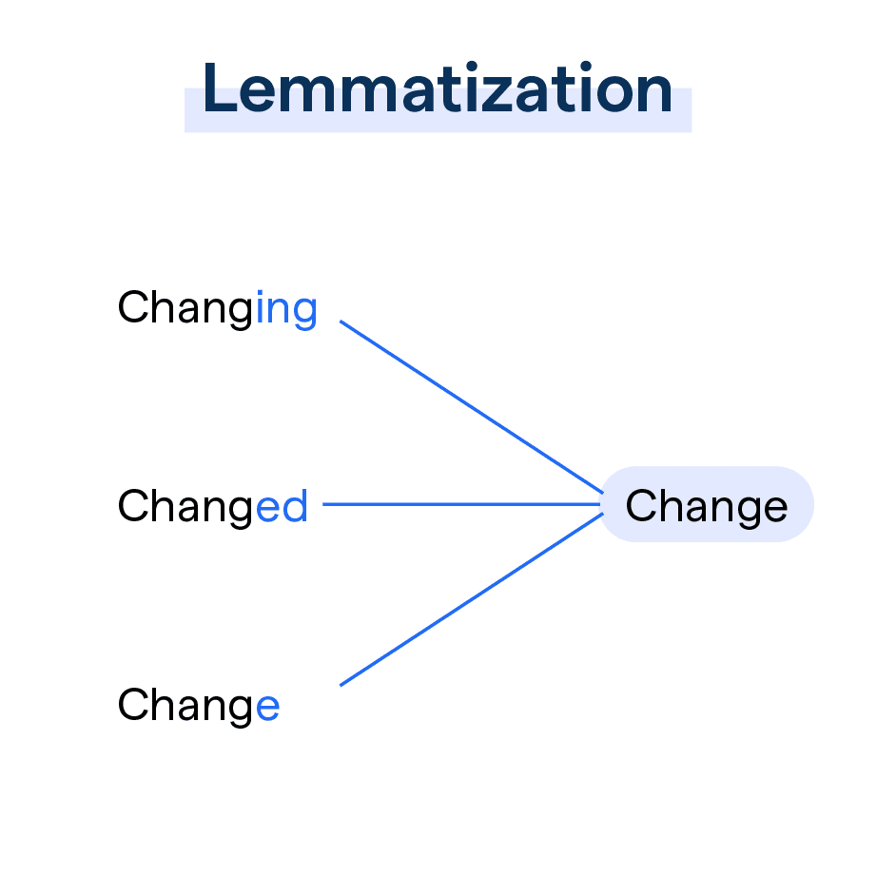
Text normalization
Lemmatization is the process of analyzing words to determine their base or root form. It's a technique used in computational linguistics and natural language processing to reduce words to their lemma, which is the canonical form of the word.

Slide 9
Work plan
Week 0
Week 2
Week 4
Week 7
Week 8
Choosing a topic
Literature review
Proof of Concept
Solution
Report
Introduction to the domain
Exploring solutions
Reading papers
Posing hypotheses and questions
Defining scope of the project, SOTA
Data analysis
Data preprocessing
Initial modeling, methods/techniques testing
Finishing modelling
Evaluation of the results
Delivering a working solution
Summarizing all work
Making conclusions
Delivering a report

Slide 10
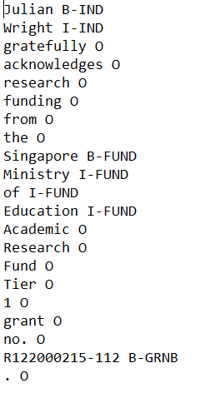
Datasets
4 corpora
dev, train, test

Slide 11
Flair Embeddings
NER model with Flair Embeddings is a method which create contextual word embeddings for text data .
consider the surrounding words and the context in which a word appears.
gives different embeddings for the same word depending on its surrounding text

Slide 12
Flair Transformers
Transformers models is an advanced approach to entity recognition in natural language processing (NLP) using transformer-based models
Using a transformers model is adapting pretrained transformer model, such as XLM-RoBERTa, as a base model and fine-tuning it on NER dataset.
During fine-tuning, it adapt to recognize entities by updating the model's weights with labeled data.

Slide 13
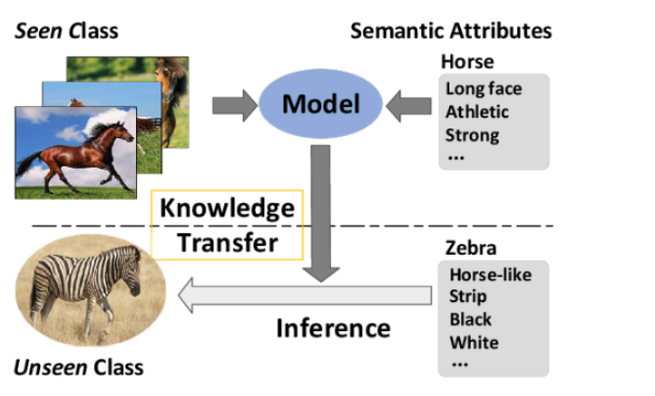
TARS(Task-Aware Representation of Sentences)
Transformer-based model
Enables training with limited data: Zero-shot and Few-shot learning

Slide 14


TARS(Task-Aware Representation of Sentences)
Transformer-based model
Enables training with limited data: Zero-shot and Few-shot learning
Considers semantic information in class labels
Requires labels to be defined in a natural language

Slide 15
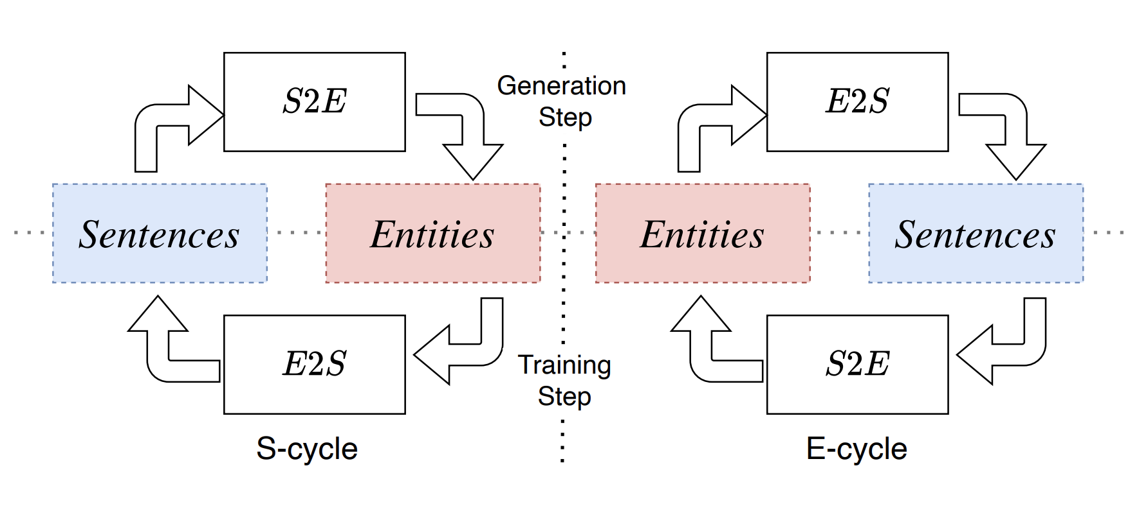
CycleNER - unsupervised approach

Slide 16
References
Smirnova, N., Mayr, P. Embedding models for supervised automatic extraction and classification of named entities in scientific acknowledgements. Scientometrics (2023)
Lovine, A., Anjie, F., Fetahu, B., Rokhlenko, O., Malmasi, S. CycleNER: An unsupervised training approach for named entity recognition. In Proceedings of the ACM Web Conference 2022 (WWW ’22). Association for Computing Machinery, New York, NY, USA, 2916-2924
Borst, T., Mielck, J., Nannt, M., Riese, W. (2022) Extracting Funder Information from Scientific Papers - Experiences with Question Answering. In G. Silvello, O. Corcho, P. Manghi, G. M. Di Nunzio, K. Golub, N. Ferro, A. Poggi (Eds.), Linking Theory and Practice of Digital Libraries (Vol. 13541, pp. 289–296). Springer International Publishing
Schweter, S., Akbik, A. (2020). FLERT: Document-level features for named entity recognition. ArXiv. 10.48550/arXiv.2011.06993
Akbik, A., Blythe, D., Vollgraf, R. (2018). Contextual string embeddings for sequence labeling. In 2018, 27th International Conference on Computational Linguistics (pp. 1638–1649)

Slide 17
Thank you for attention

